Slide 1



Slide 2

Last lecture reminder
We learned about:
Different types of errors in software programs
Introduction to error handling and how we should apply it
Error handling in Python:
try - except block
The finally keyword
Create and throw custom exceptions
Lambda functions in Python

Slide 3
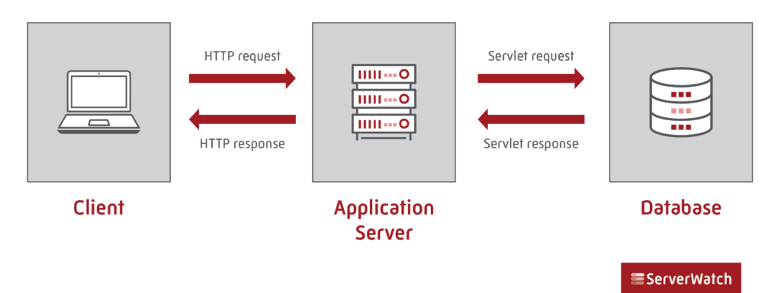
What is a Database?
Database is the place where we store information that we want to save for long time.
For example: Website usernames and passwords should be stored in a database in order to allow them to logout and login again any time they want. Without storing the usernames and passwords information our website could not use this information once the users exit the website.

Slide 4
Different types of Databases
We can use a lot of ways to store Data, any data storage we use can be called a database.
Phone numbers → Store on paper
Shopping list → Store In your mind
Todo list → Store on a computer
Presentation comments → Store inside this powerpoint
Trip pictures → Store inside your smartphone
From all the ways we have to store data, storing data that related to web applications in a dedicated computer is the best option.

Slide 5
Why using computer database?
There are couple of main reasons why we choose to use computers as our database storage:
Computers are always ready to serve → Database should be 100% of the time available to serve requests for store and get data
Computers can store almost unlimited amount of data → As the usage of our website grow, so the data we need to store in our database. Computers allow us to not limit our storing size.
Computers are very fast → Our users expect from our website to run and operate as fast as it can. In order to do that we need to store and get data from our database as fast as we can as well.
We can connect to computers from anywhere we want → Most websites should work from anywhere in the world, so our database should be able to connect to anywhere in the world as well.

Slide 6
Two Main Types Of Databases
Relational Databases (SQL) - Main characters:
Organized data into one or more tables
Each table has its own columns and rows
A unique key identified each row in the table
Non-Relational Databases (NoSQL) - Main characters:
Storing data in anything but the traditional tables, for example:
Key - value stores
Documents (JSON, XML, etc)
Graphs
Flexible Tables
Note: Any database that not operate like a relational database, will put in the non-relational database category

Slide 7
Database Management System (DBMS)
In order to allow interaction with the concrete database we need to connect and interact with the database management system (DBMS) This system allow us to perform actions on the database such as:
Manage large amount of information
Handle security (User & Password)
Buckups
Importing / exporting data
Concurrency
Interact with software applications (Such as Java / python / Node.js applications)

Slide 8

Database Management System (DBMS)
Amazon web application, like any other web application in the world use the DBMS to interact and perform actions on the database like: create, read, update and delete (CRUD). In addition to other actions like security, data backup and more.

Slide 9







Relational Databases (SQL)
When we choose to use relational database we also need to use a relational database management system such as:
MySQL
SQL SERVER
PostgreSQL
H2
SQLite
For non relational databases we have:
MongoDB
ElasticSearch

Slide 10

Database Queries
Queries are the way we can interact with the database management system in order to get existing data from the database or create / update / delete data. Queries are used in relation databases and in non-relational databases as well. Note: As the database structure become more and more complex it will make our query more complicated and will take more time from the database to return the result we wanted.

Slide 11
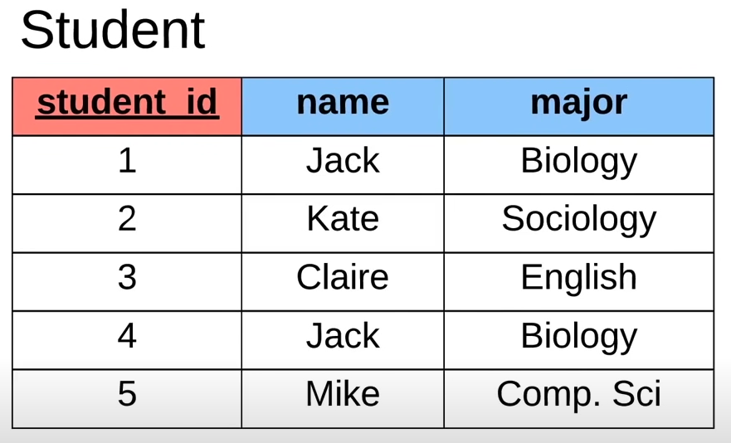
Relational Databases Introduction
Relational databases are based on tables and keys. Table – Relational database structure that hold related information inside.
For example: If we want to store all the data we have that is related to students we should create a Student table that should look like this:

Slide 12
Relational Databases Introduction
Row → Each new student that we will save inside the table will open a new row
Column → Each property that we want to save about the student will open a new column
Node: Table name will always be in singal, Student (not Students)
columns
rows

Slide 13
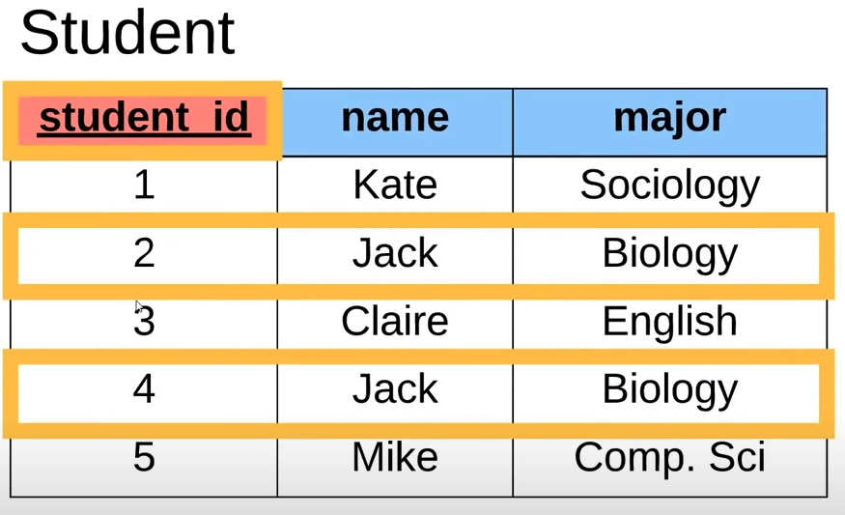
Relational Databases Introduction
Key → Every table in a relational database must have a specific column that will be the table key. For being the table key, this column must always be unique for each row, which means this key won't repeat it self. The table key allow our database to differentiate between the different rows and return the specific row that we are looking for.

Slide 14
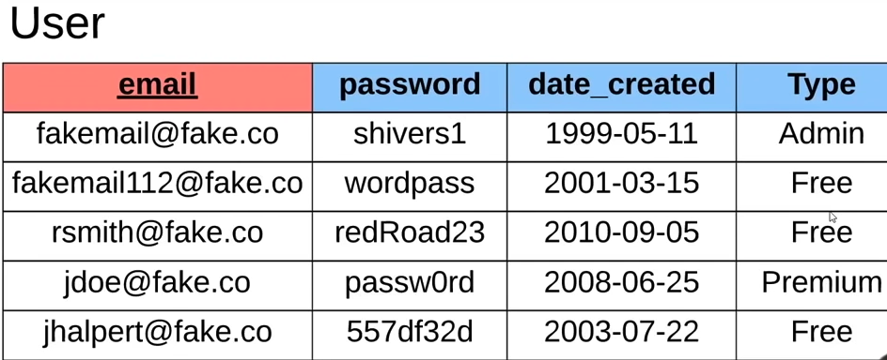
Relational Databases Introduction
Let’s look at another example – User table: This time the table key is the user email

Slide 15
Primary Key & Foreign Key
Primary Key → Another name to table key is primary key, primary key is the main key of the table and as we learn every database table must have a primary key and this primary key can appear only once inside the table and can not be null. Foreign Key → The name of a reference from a different table column to the primary key of another table is been called a foreign key. With foreign key we can associate between data from different tables. Foreign key will be another column inside the database table but because it just referred to a primary key of another table it can be null and can repeat itself.

Slide 16
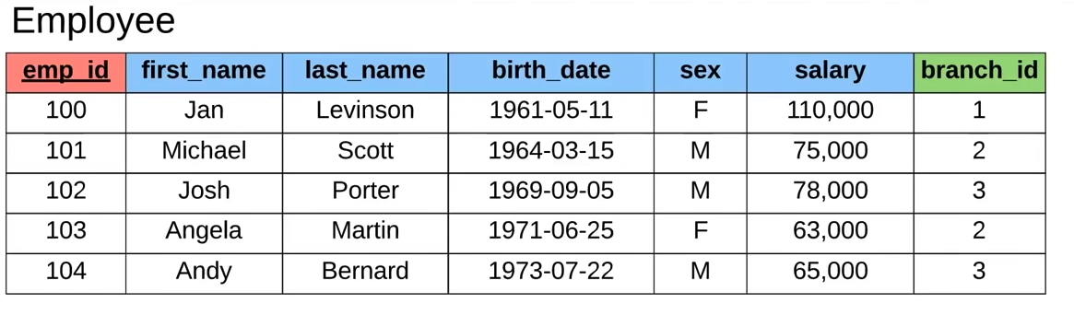
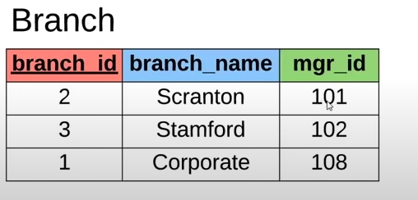
Primary Key & Foreign Key
Let’s take a look at a primary key - foreign key example:
Foreign key to Branch table

Slide 17
Composite Primary Key
Composite Primary Key → When we have a primary key that is a combination of more than one column we will call it a composite key. When using a composite key each column by itself can repeat it self, but the combination of the columns together can not. For example: let’s say we have a Student table with a composite primary key of (first name, last name), and we have the row: “Ben”, “Meir”, 32 Because the primary key is a composite key, we can have another student with first name “Ben” and another student with last name “Meir” but we can’t have another student with first name “Ben” and last name “Meir” together.

Slide 18
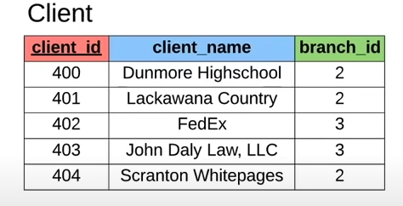
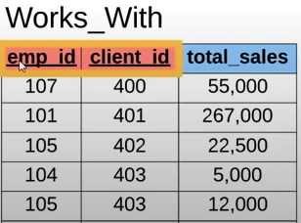
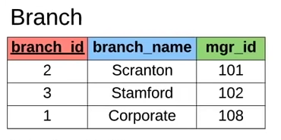
Composite Primary Key - Example
Composite primary key of emp_id and client_id

Slide 19

Tables & Entities Relationship
As we learned, we can connect every relational table in the DB to another table by using a foreign key. This connection allow us to represent a relationship between the 2 tables. We can also call this relationship granularity.

Slide 20
Tables & Entities Relationship
We can have 3 different relationship types between 2 tables:
One To One - Each row from the first table has exactly one row match from the second table, and Each row from the second table has exactly one row match from the first table.
One To Many - Each row from the first table can have more than one match from the second table, but each row from the second table can have exactly one match from the first table.
Many To Many - Each row from the first table can have more than one match from the second table, and each row from the second table can have more than one match from the first table.

Slide 21
Tables & Entities Relationship - Examples
Let’s see an example for each table relationship from real life:
One To One - ID number & Person → Each person can have only one ID number. Each ID number can be associated to only one person.
One To Many - Credit Card & Person → Each person can have more than one credit card. Each credit card can be associated to only one person.
Many To Many - Job title & Person → Each person can have more than one job title. Each job title can be associated with more than one person.

Slide 22
Class Exercise - Relational Database Keys & Tables
Instructions:
Create a relational database schema that represent the following: Your program should save users info, each user have id, first name, last name, password, email. In addition, each user can sign up to 2 students to a course (a user can also sign himself). Your program should save each student id, first name, last name, age, phone number and the course he was signed to. If the student was signed by a registered user your program should save that as well. In addition, your program should save all courses data, this data contain id, course name, course date, max number of students in class.

Slide 23
Class Exercise Solution - Relational Database Keys & Tables

